Slide 1
SOFTWARE DEFINED CAMERA FOR OUTDOOR SURVEILLANCE APPLICATIONS ID : 08
ROLL NO NAME CGPA
CS-18110 HOOR SOOMRO 2.76
CS-18118 MISHA AKRAM BAIG 3.489
CS-18123 IQRA IRFAN 3.579
CS-18133 SONIYA SHAFI 3.863

Slide 2
Introduction
Image acquisition is an integral part of digital image processing and computer vision applications.
The accuracy of their algorithms is highly dependent on the quality of the input image as greater the image quality better the result of the algorithms.
Usually, conventional cameras are available with fixed functionality and image quality.
A more efficient technique is to replace these conventional cameras with an adaptable smart camera so that pre-processing can be performed for accomplishing the desired constant and high quality output.

Slide 3
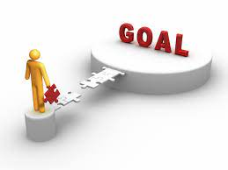
Our goal
Therefore our Goal is to control quality parameters by configuring sensor registers before image capture. Final fine tuning could be done by simple pre-processing.
Notes:
Goal is to control quality parameters be configuring sensor registers before image capture. Final fine tuning could be done by simple pre-processing

Slide 4
task Division

Slide 5
MIleStones
LITERATURE REVIEW
TOOLS LEARNING
ENVIRONMENT PROFILING
CAMERA INTEGRATION AND CALIBRATION
DOCUMENTATION
TESTING AND VALIDATION
DESIGNING OF IPS

Slide 6
Literature review
The authors of [1] use Field Programmable Gate Array (FPGA) architecture for making preprocessing faster. As the FPGA architecture has the ability to perform parallel processing, it will shorten the processing time and the efficiency will increase.
Edge computing eliminates the need to send image data to serverside for processing. Provides a way to process the images directly on the camera by taking advantage of sensors and the use of end devices to take over the load of processing [2].
In [3] the detection and recognition tasks for surveillance are executed locally by edge devices. Only when devices are not able to execute the recognition task, a recognition request is sent to the server.

Slide 7
Considering the hype of AI, the implementation of solutions to image enhancement problems are currently limited to use of these traditional strategies, mostly.[4][5]
The idea of the Software-Defined Smart Camera is to use simpler methods to avoid complexity
So, instead of using these computational extensive algorithms, pre-processing techniques are to be used
i.e. in our case, manipulating and adjusting register values of the image sensor, to improve image quality at the time of being captured.

Slide 8
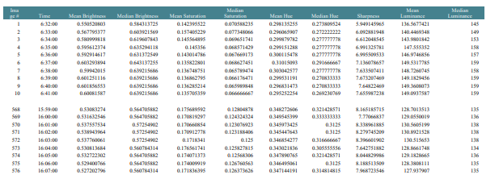
Environmental profiling
The camera was made to capture the images at regular intervals. These images were then analyzed in MATLAB and their certain parameters were calculated. It help in determining the most relevant parameters which can be later manipulated.

Slide 9
Image parameters
After environmental profiling, the parameters which we decide to consider include
Brightness
Saturation
Contrast
Sharpness
Black Level Calibration

Slide 10
Brightness
Brightness is simply how dark or light a picture is. Correct brightness is important to easily understand the contents of the picture. Changing the brightness of a picture affects all pixels equally.
Effect of Increasing Brightness on other Parameters
Brightness | Contrast | Saturation | Sharpness
medium | reduce | reduce | reduce
extreme | extremely reduced | extremely reduced | extremely reduced
Notes:
These tables are not understandable. Not conveying what you want to present. Could be showed in a better way here

Slide 11
Saturation
The depth or intensity of color present within an image. The more saturated an image is the more colorful and vibrant it will appear.
Effect of Increasing Saturation on other Parameters
Saturation | Brightness | Contrast | Sharpness
increased | enhanced | enhanced | enhanced
Notes:
These tables are not understandable. Not conveying what you want to present. Could be showed in a better way here

Slide 12
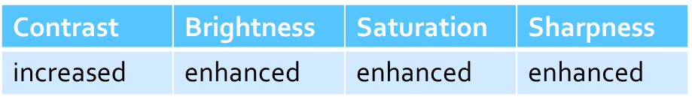
contrast
The separation between the darkest and brightest areas of the image.
Effect of Increasing Contrast on other Parameters
Notes:
These tables are not understandable. Not conveying what you want to present. Could be showed in a better way here

Slide 13
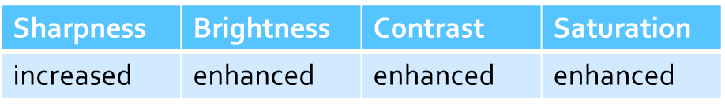
sharpness
Sharpness can be defined as edge contrast, that is, the contrast along edges in an image.
If sharpness is increased, the contrast along/near edges is increased while leaving smooth areas of the image alone.
Effect of Increasing Sharpness on other Parameters
Notes:
These tables are not understandable. Not conveying what you want to present. Could be showed in a better way here

Slide 14
Camera analysis
Identifying adjustable image sensor registers and their minimum and maximum values
Observing the effects of these registers on the image quality within a particular environmental condition
Studying and analyzing the output image obtained
in order to select the most desirable register values with respect to the environment.

Slide 15
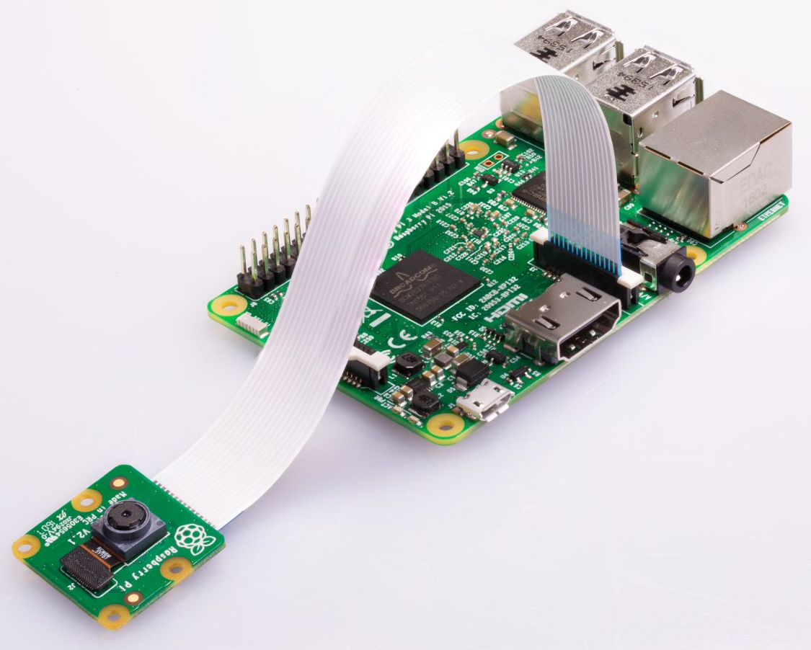
Problem faced
For camera analysis we need Image Sensor OV5640, which was not available.
We searched different options and found that the image sensor in PiCamera i.e. OV5647, is similar to OV5640 in many aspects.
So, for proof of concept, we started with available resources.
But our ultimate target is OV5640, which we will hopefully get.
Notes:
Don’t use words like “stuck”. It gives a very bad impression. Rather use for proof of concept, we started with available resources. But our ultimate target is OV5640, which we will hopefully get

Slide 16
Similarity between ov5640 and 0v5647
OV5640 | OV5647
RESOLUTION = 2592 X 1944 | RESOLUTION = 2592 X 1944
Automatic image control functions: automatic exposure control (AEC), automatic white balance (AWB), automatic band filter (ABF), automatic 50/60 Hz luminance detection, and automatic black level calibration (ABLC) | Automatic image control functions: automatic exposure control (AEC), automatic white balance (AWB), automatic band filter (ABF), automatic 50/60 Hz luminance detection, and automatic black level calibration (ABLC)
lens size: 1/4" | lens size: 1/4"
Maximum image transfer rate: QSXGA (2592x1944): 15 fps 1080p: 30 fps 1280x960: 45 fps 720p: 60 fps VGA (640x480): 90 fps QVGA (320x240): 120 fps | Maximum image transfer rate: QSXGA (2592x1944): 15 fps 1080p: 30 fps 1280x960: 45 fps 720p: 60 fps VGA (640x480): 90 fps QVGA (320x240): 120 fps
Pixel size: 1.4 µm x 1.4 µm | Pixel size: 1.4 µm x 1.4 µm
Notes:
Instead of specs sheet, make a table of similar features and explain

Slide 17
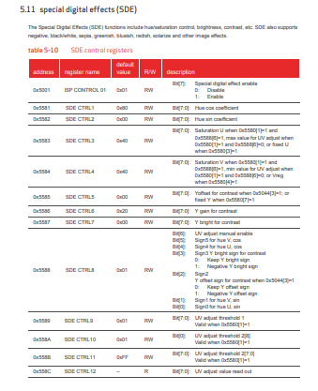
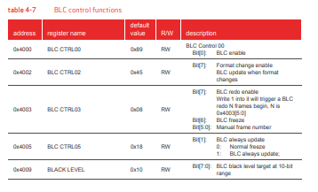
registers
Notes:
Explain them well during presentation.

Slide 18
Finally Success
In RaspberryPi as there is restricted OS and Libraries, register level information of the image sensor is not accessible.
We also tried different possibilities such as I2C, UART etc.
Finally, we found that changes can be made through command lines
Every parameter ranges between 0 to 100, where 0 represent the minimum value and 100 represents maximum.
This gives us the POC that the parameters can change and are not fixed like traditional cameras.
Notes:
Don’t use word “fail”. Rather you can say we tried different possibilities such as I2C, UART etc. we found that changes can be made through command lines

Slide 19
Live streaming
In order to observe the effects of changing values of parameters, different pictures were captured.
A live stream is also created to ensure that the parameters are not fixed and are changeable.
http://192.168.43.223:8000/index.html
Notes:
What is this? http://192.168.43.223:8000/index.html
It is link of live stream which we Have made

Slide 20
Intellectual property (IP)
An IP (intellectual property) core is a block of logic or data that is used in making a field programmable gate array ( FPGA ) for a product.
IP cores can be categorised as hard IP core, firm IP (semi-hard IP) core and soft IP core.
Soft IP cores are IP blocks generally offered as synthesizable RTL models. These are developed in one of the Hardware description language like SystemVerilog or VHDL.

Slide 21
Future plan
In order to configure registers according to environmental conditions IPs will be designed on FPGA.
Testing and validation will be done with respect to each aspect to ensure correctness of the product.
Notes:
Now connect IPs with registers. For e.g. you can say that
In order to configure registers according to environmental conditions Ips will be designed on FPGA. Here explain IPs also.

Slide 22
REFERENCES
[1] M. Yildirim and A. Çinar, "Simultaneously Realization of Image Enhancement Techniques on Real-Time Fpga," 2019 International Artificial Intelligence and Data Processing Symposium (IDAP), Malatya, Turkey, 2019, pp. 1-6
[2] Ahmed, E., Ahmed, A., Yaqoob, I., Shuja, J., Gani, A., Imran, M. and Shoaib, M. (2017). Bringing Computation Closer toward the User Network: Is Edge Computing the Solution?. IEEE Communications Magazine, 55(11), pp.138-144.
[3] H. Kavalionak, C. Gennaro, G. Amato, C. Vairo, C. Perciante, C. Meghini and F. Falchi, ”Distributed video surveillance using smart cameras,” Journal of Grid Computing, 17(1), 2019
[4] Y. Wang, J. Zhang, Y. Cao and Z. Wang, "A deep CNN method for underwater image enhancement," 2017 IEEE International Conference on Image Processing (ICIP), Beijing, 2017, pp. 1382-1386.
[5] W. Ren et al., "Low-Light Image Enhancement via a Deep Hybrid Network," in IEEE Transactions on Image Processing, vol. 28, no. 9, pp. 4364-4375, Sept. 2019.

Slide 23


